Slide 1
From Here to There

Slide 2
Using the Location Sensor
Provides the current longitude and latitude
Had a method to translate longitude and latitude to an address

Slide 3
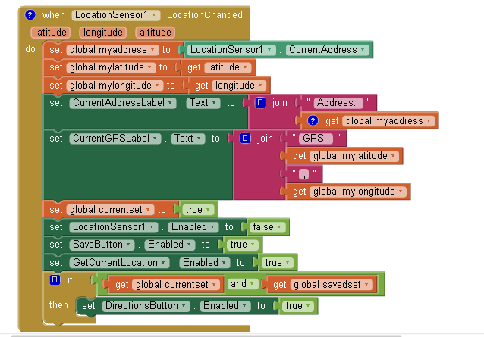

Slide 4
Using the Activity Starter
Passes information to another app on the mobile device
Starts the app

Slide 5
