Slide 1
NoodleTools Helps you stay organized
Taking notes

Slide 2
What is NoodleTools?
Gather, organize, think, create
Begin a working bibliography
Copy-and-paste relevant quotes onto notecards
Paraphrase the author’s words
Analyze, question and add your own ideas
Tag and pile your notes – what emerges?
Create an outline, add piles – reorder and experiment!
Create [essay, speech, product…] with a bibliography
Notes:
Note: There are tutorials on notecards, tagging and other features of the Tabletop here: http://www.noodletools.com/helpdesk/index.php?action=downloads#category-3

Slide 3
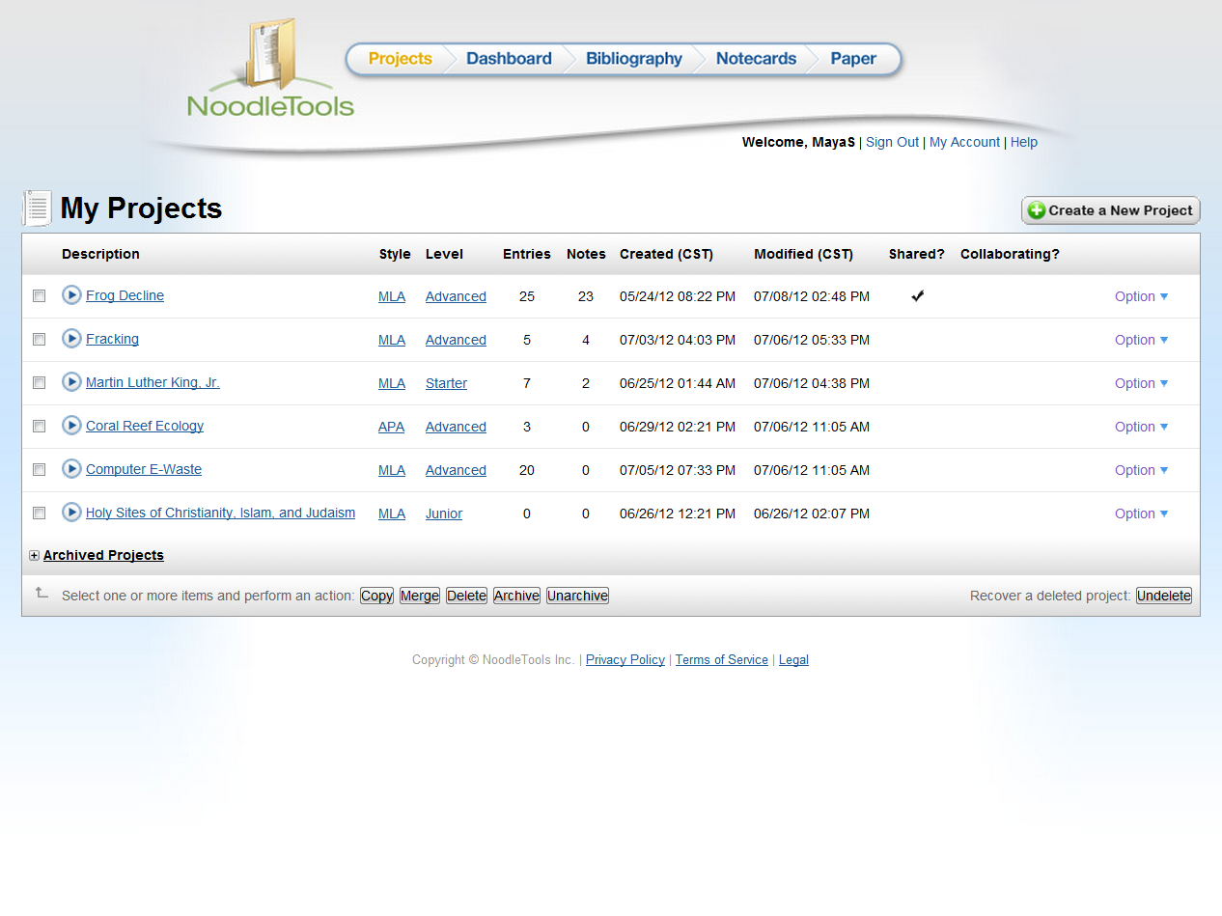
Your work is organized into projects.
Open an existing project …or start a new one
Notes:
http://www.noodletools.com/noodlebib/usersguide/index.html?n=Overview2.html

Slide 4
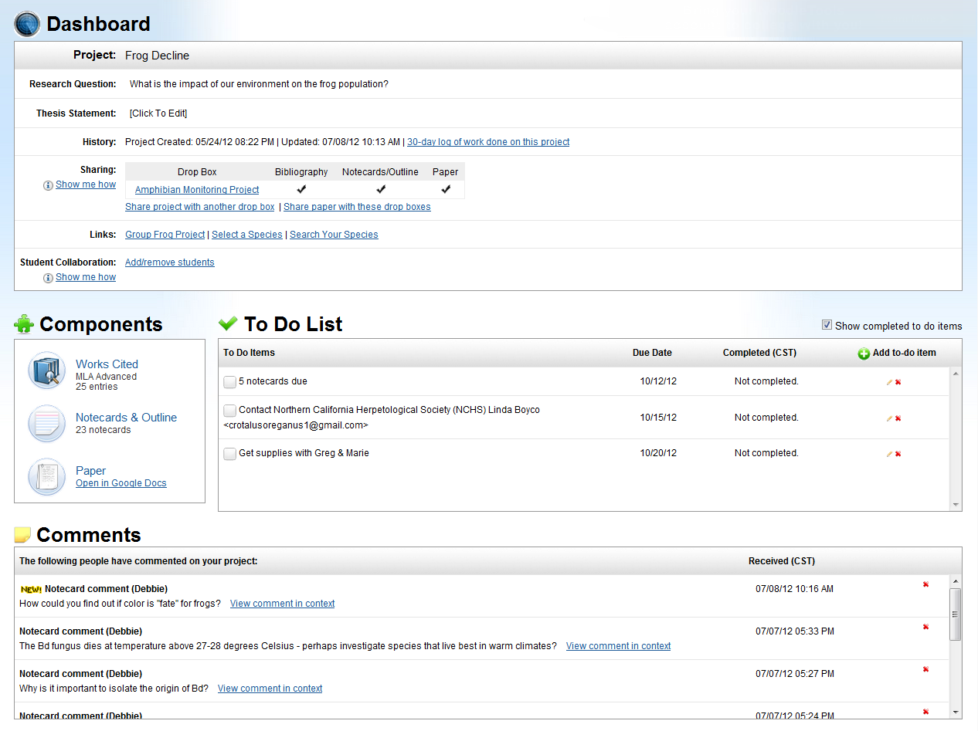
Manage your project from the Dashboard
Notes:
Your question, teacher assignments, student collaborators

Slide 5
Find “big picture” info here:
Research question
Assignments
Group members
Notes:
Your question, teacher assignments, student collaborators

Slide 6
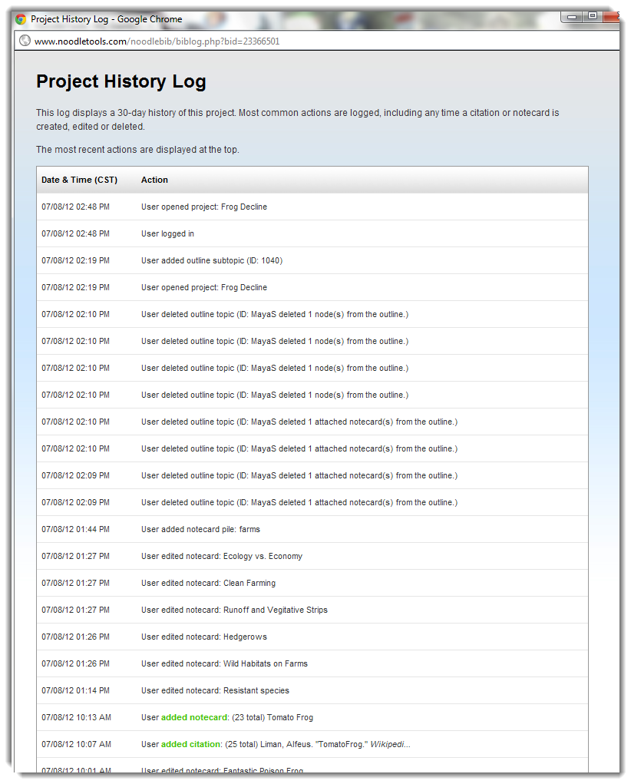
All your work is here including a record of what you’ve done!
Notes:
Your question, teacher assignments, student collaborators

Slide 7
You can add reminders to yourself
Notes:
Your question, teacher assignments, student collaborators

Slide 8
Read feedback … then revise in an organized way
Notes:
Your question, teacher assignments, student collaborators

Slide 9
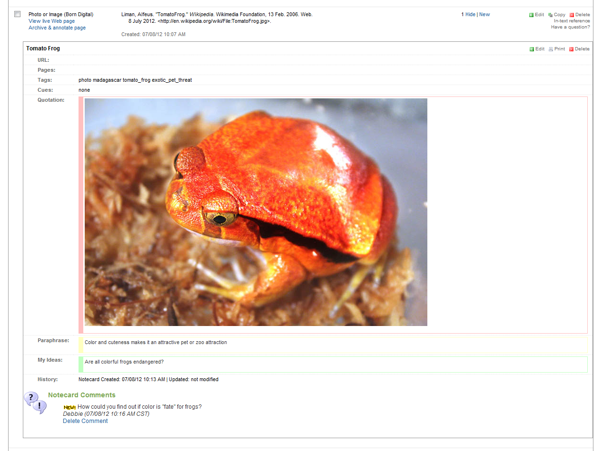
See feedback right on your notecard
Notes:
http://www.noodletools.com/noodlebib/usersguide/index.html?n=CreatingANotecard.html

Slide 10
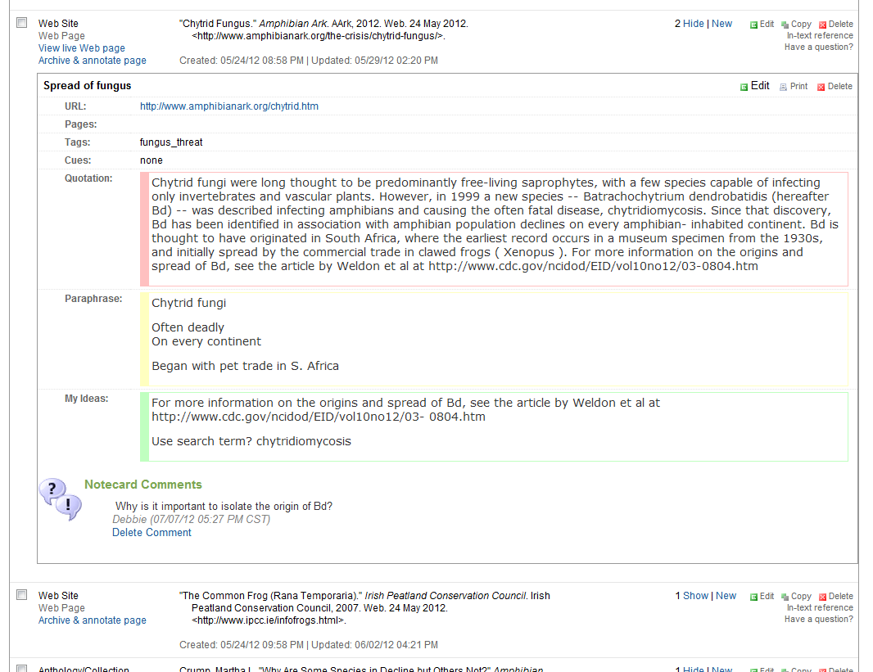
Source
Notes
Feedback
Everything stays linked

Slide 11
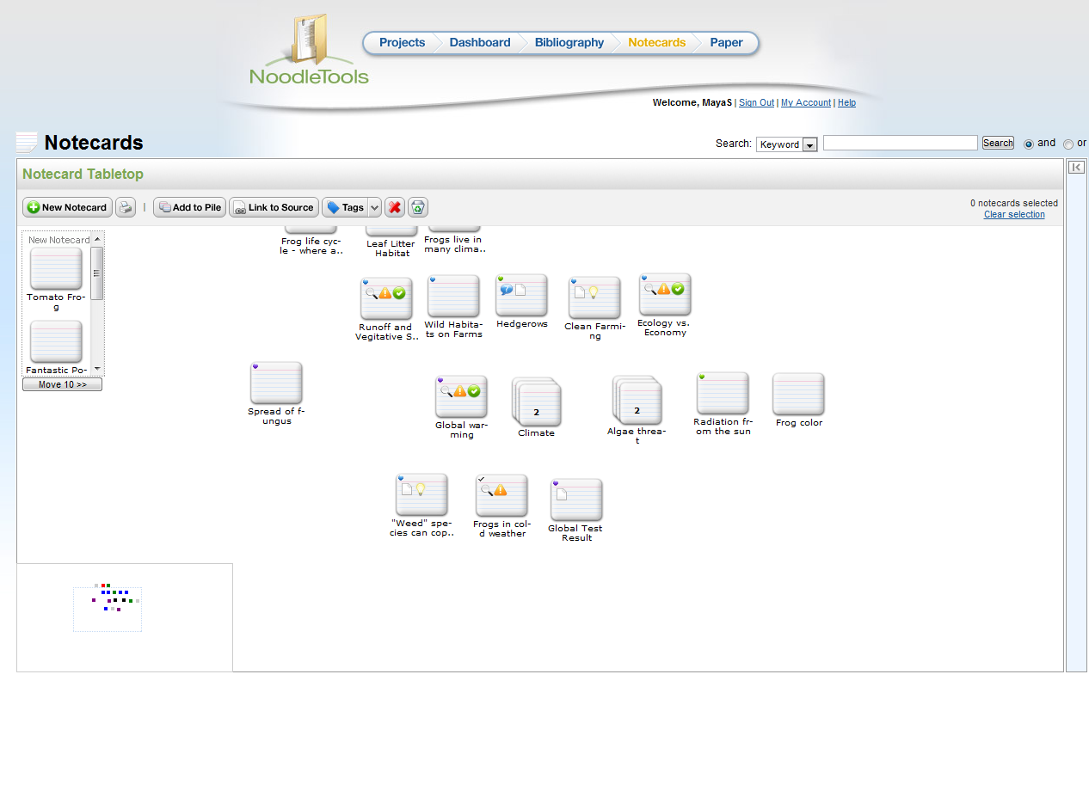
Go to the tabletop to see all your notecards

Slide 12
Check the bird’s eye view for out-of-sight notecards

Slide 13
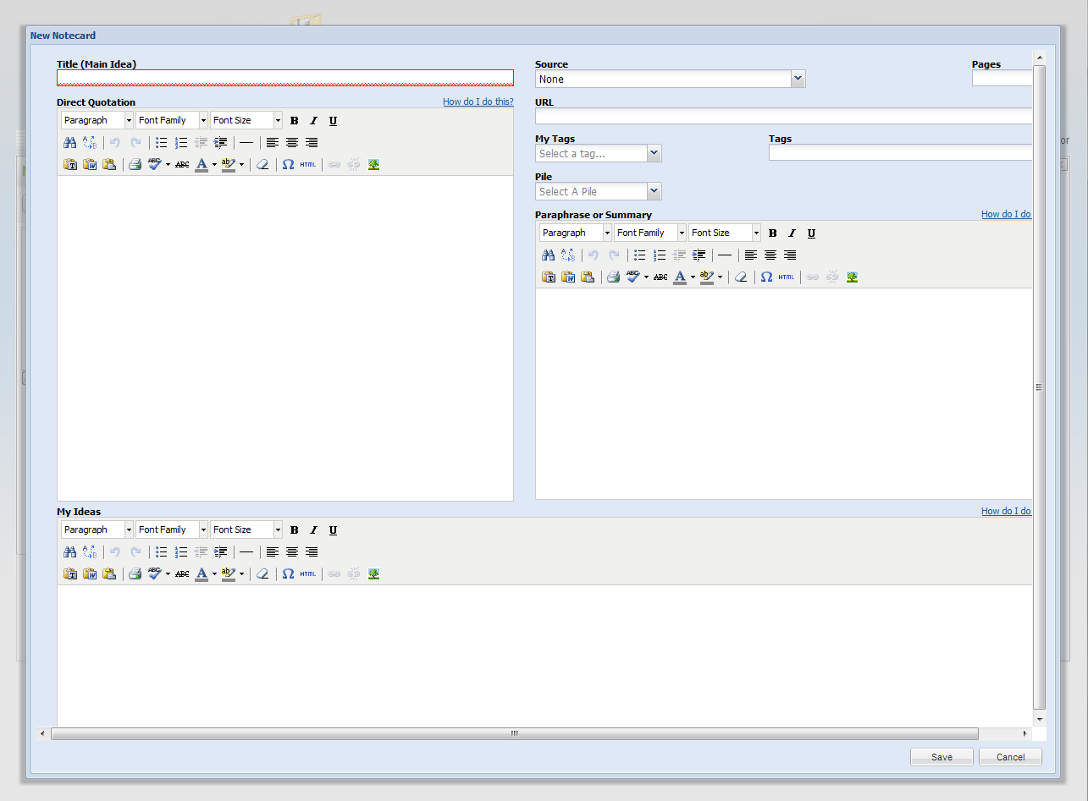
A notecard is an organizer for ideas
Copy and paste here
Capture the author’s words and images
Get quotes and attribution right
Mark up the quote

Slide 14
Paraphrase or summarize
Paraphrase here
Explain it to yourself
In words you understand
Look back at the quote – got it all?

Slide 15
“My Ideas” is for questions, brainstorming…
Original thinking here
What do you wonder?
How does this fit with what you know?
What can you follow up on?

Slide 16
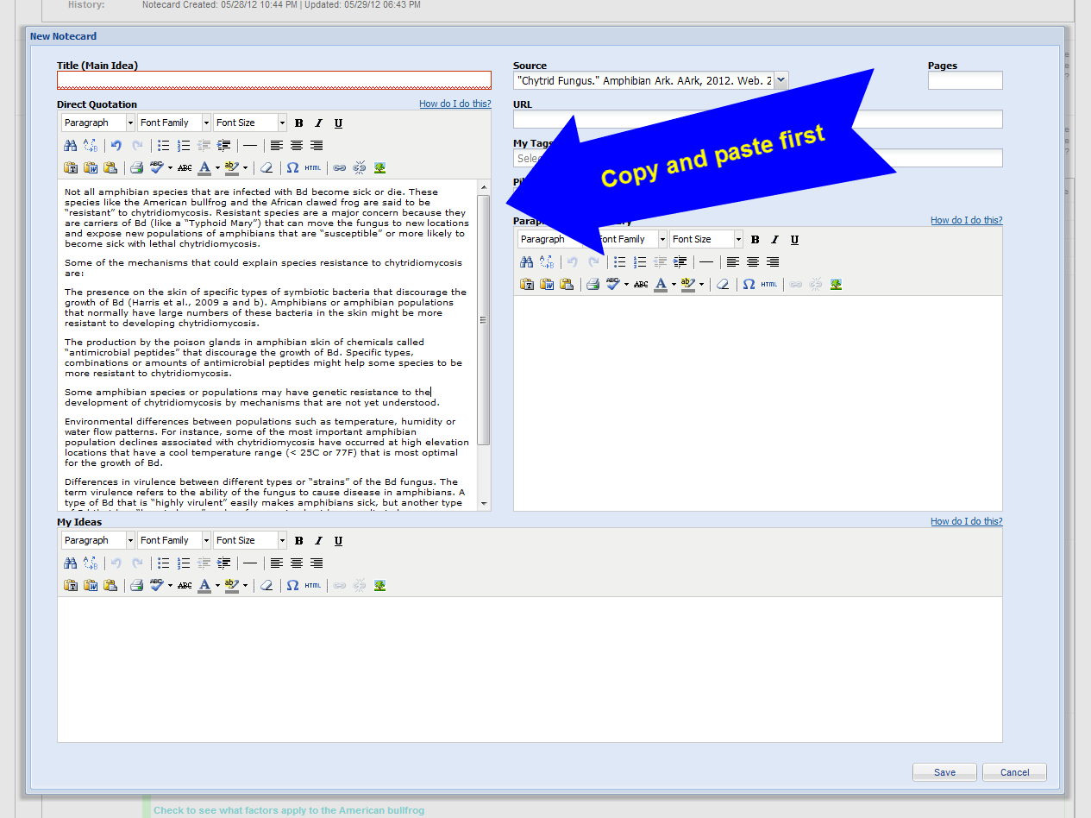
You’ll get quotes and attribution right!

Slide 17
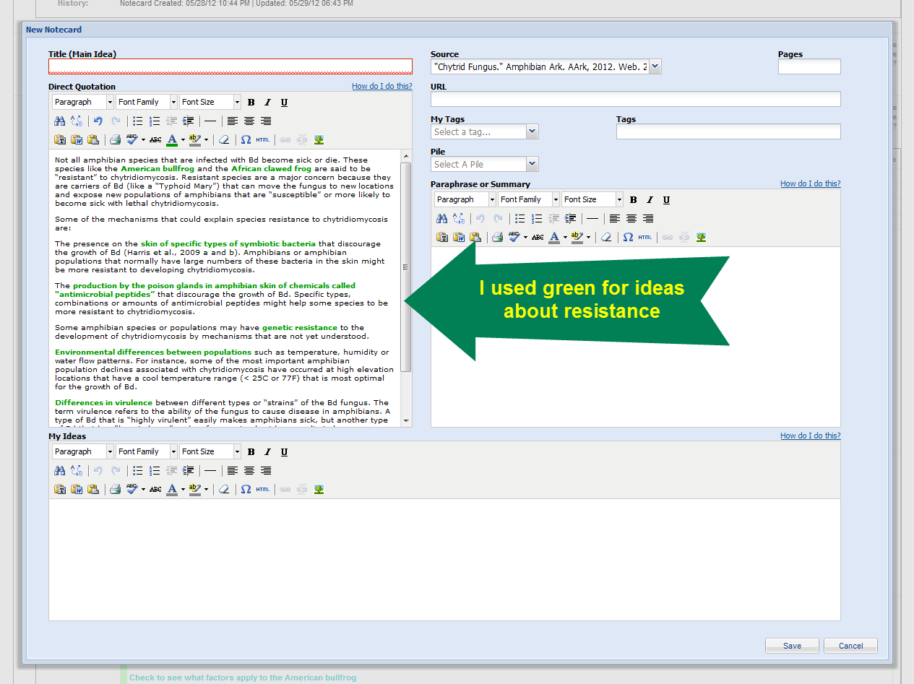
Then start to mark it up

Slide 18
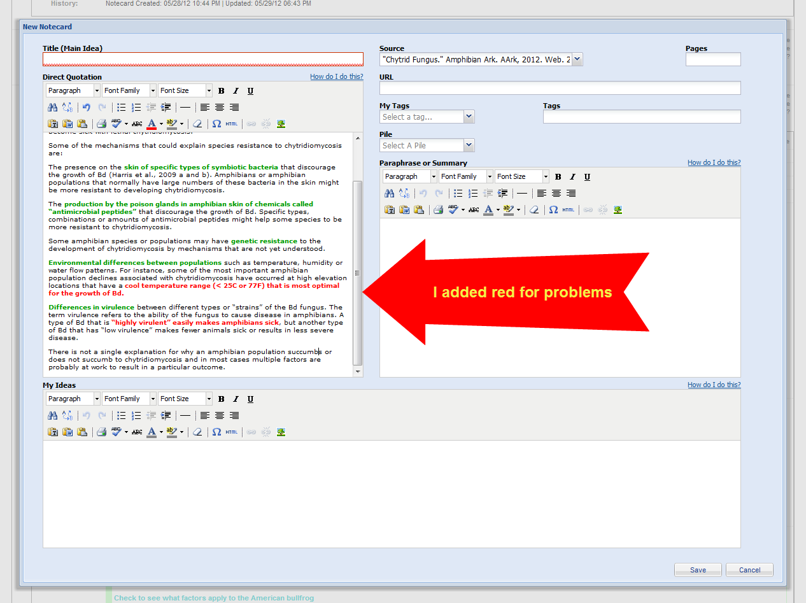

Slide 19
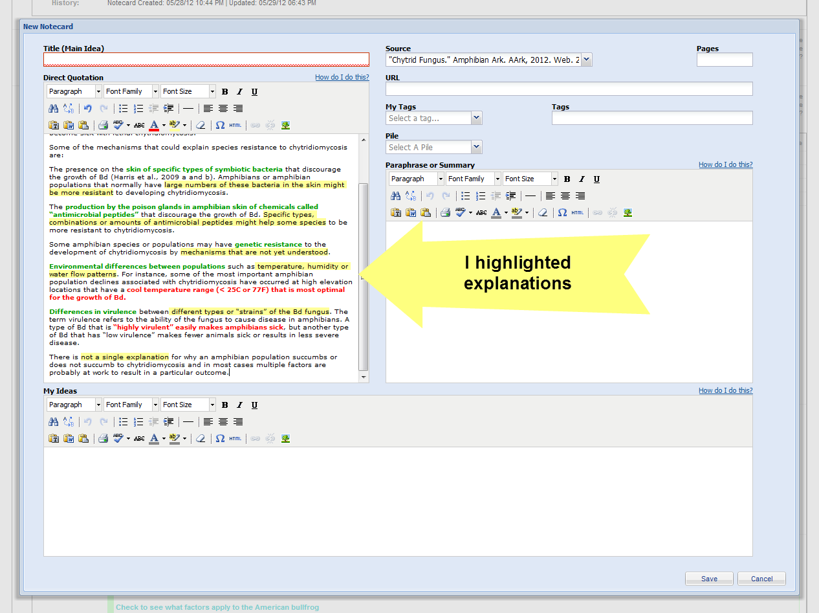

Slide 20
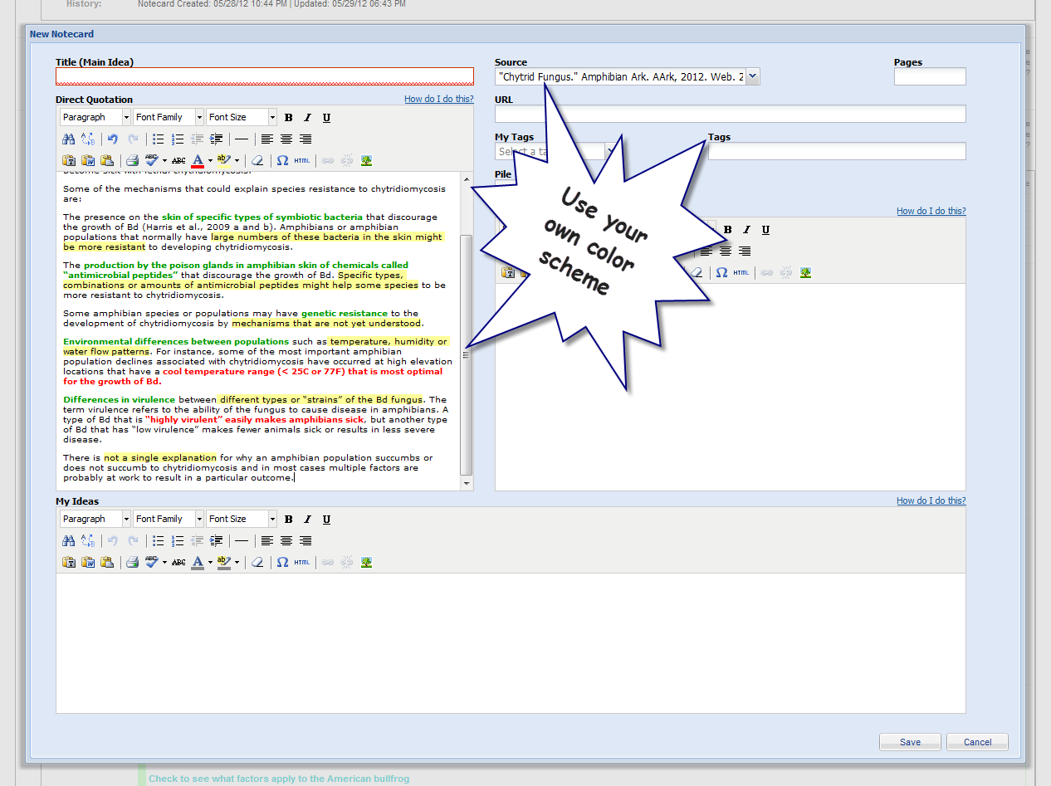
Help
Close reading boosts your comprehension

Slide 21
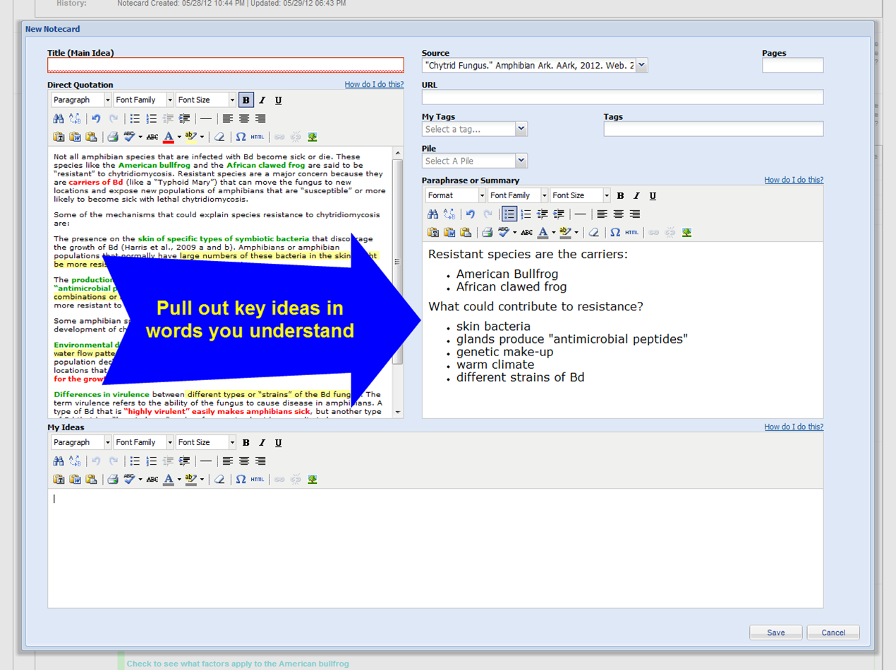
Explain it to yourself
Help

Slide 22
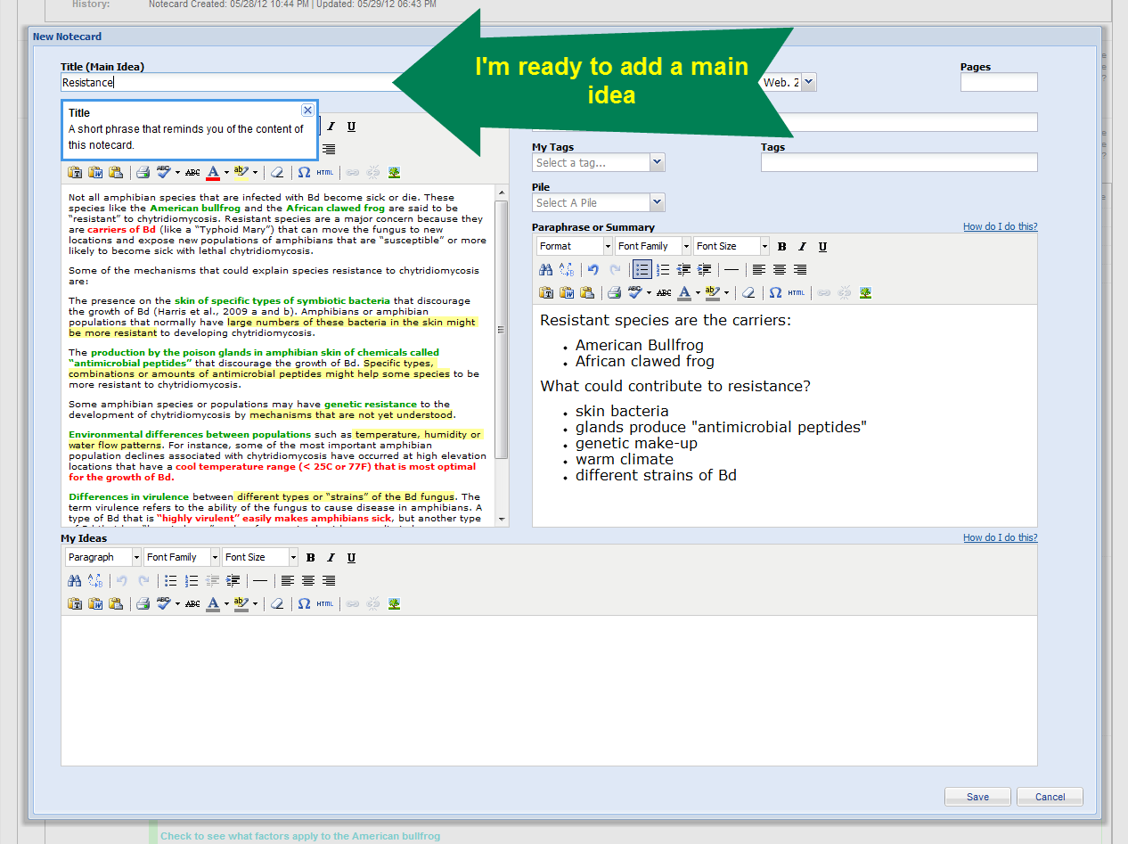
If you have trouble identifying a main idea:
Reread the quote to get the “gist.”
Is there more than one main idea? If so, just split your quote into two notecards.

Slide 23
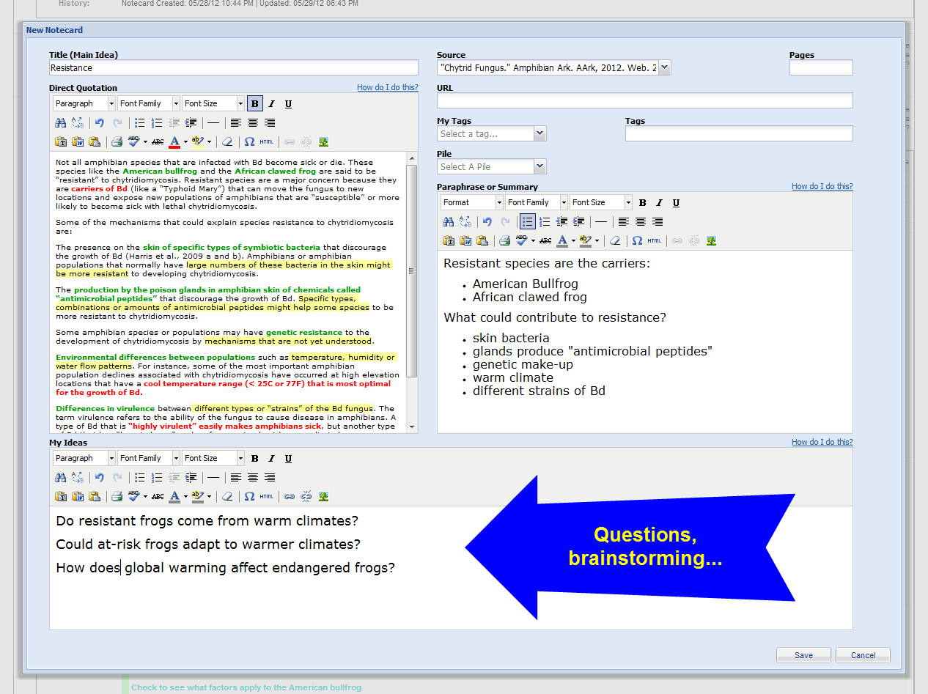
Help

Slide 24
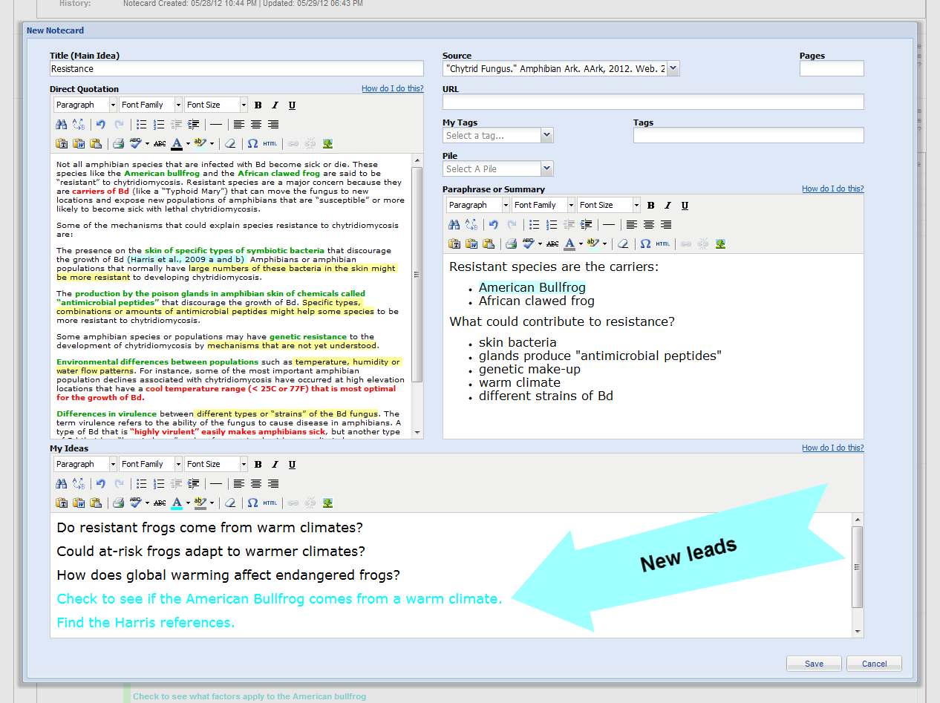
Use “My Ideas” in a flexible way

Slide 25
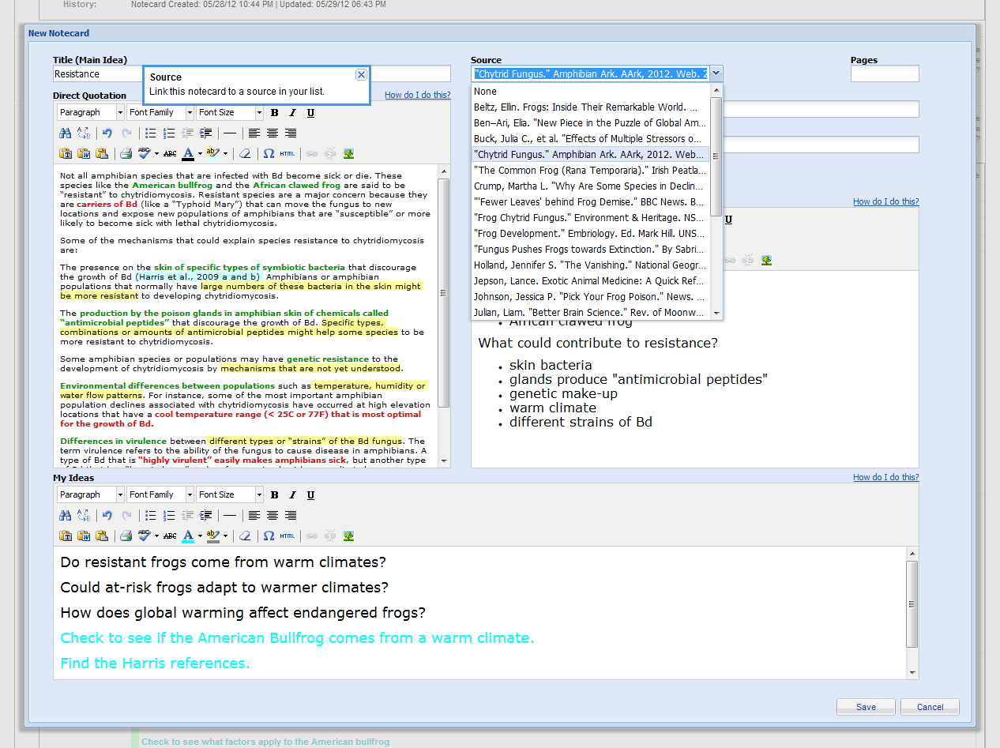
If your note isn’t linked to a source, find it in this list of all your sources

Slide 26
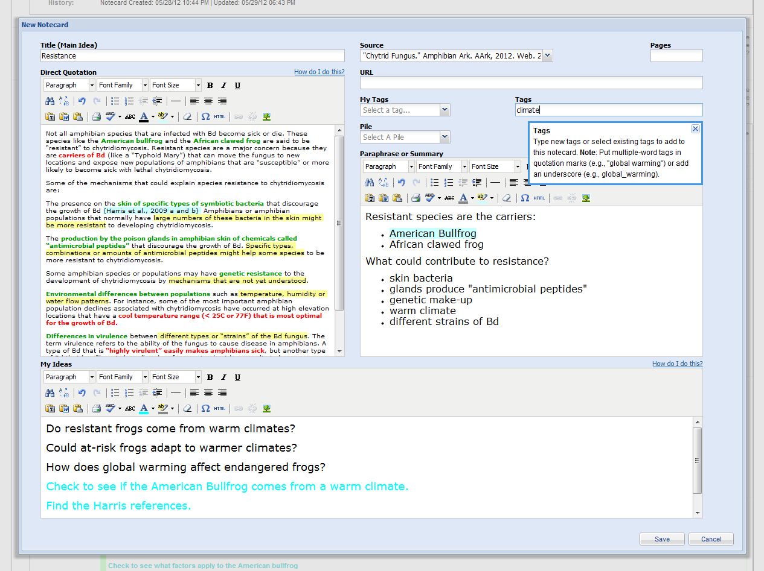
If you can, add a tag now…

Slide 27
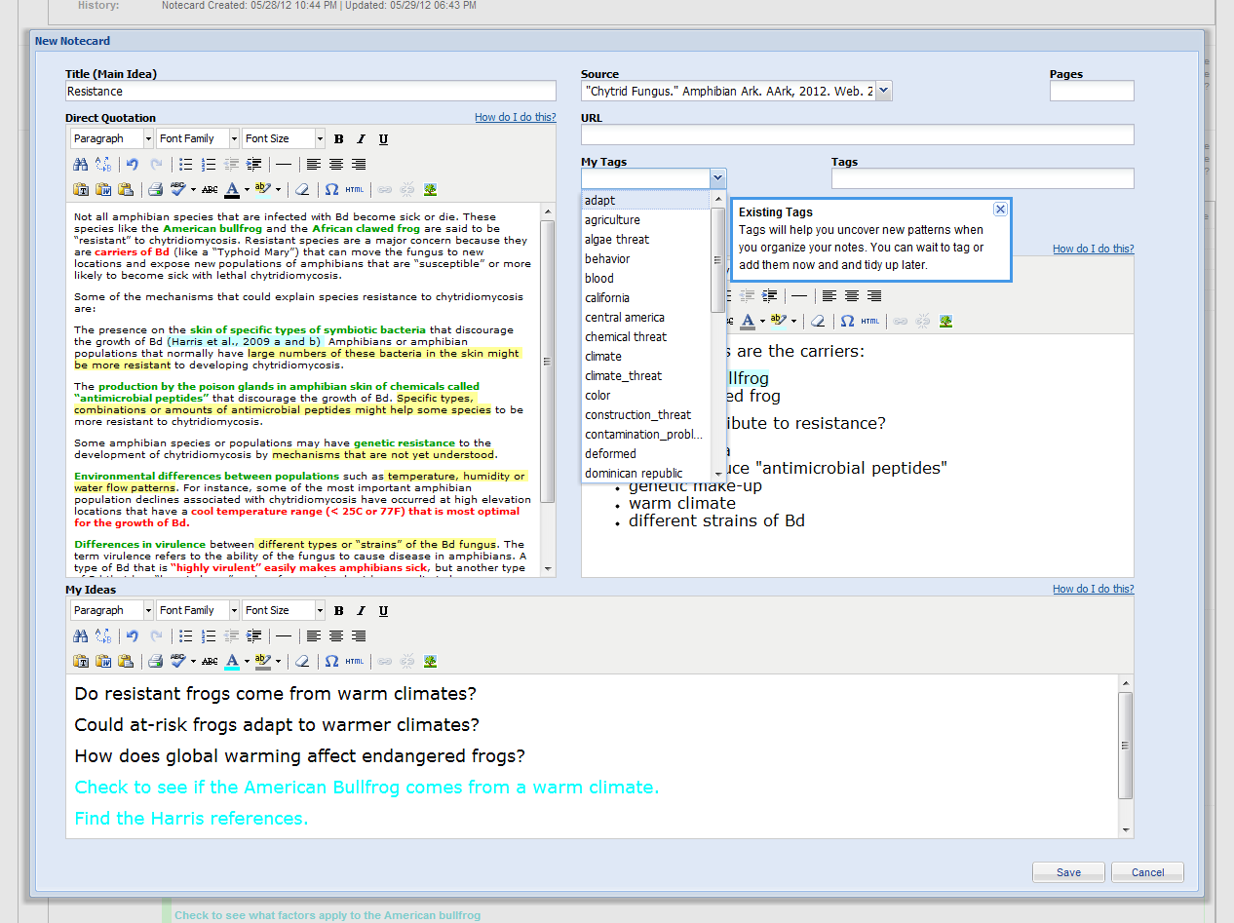
…when you know more it will be easier!

Slide 28
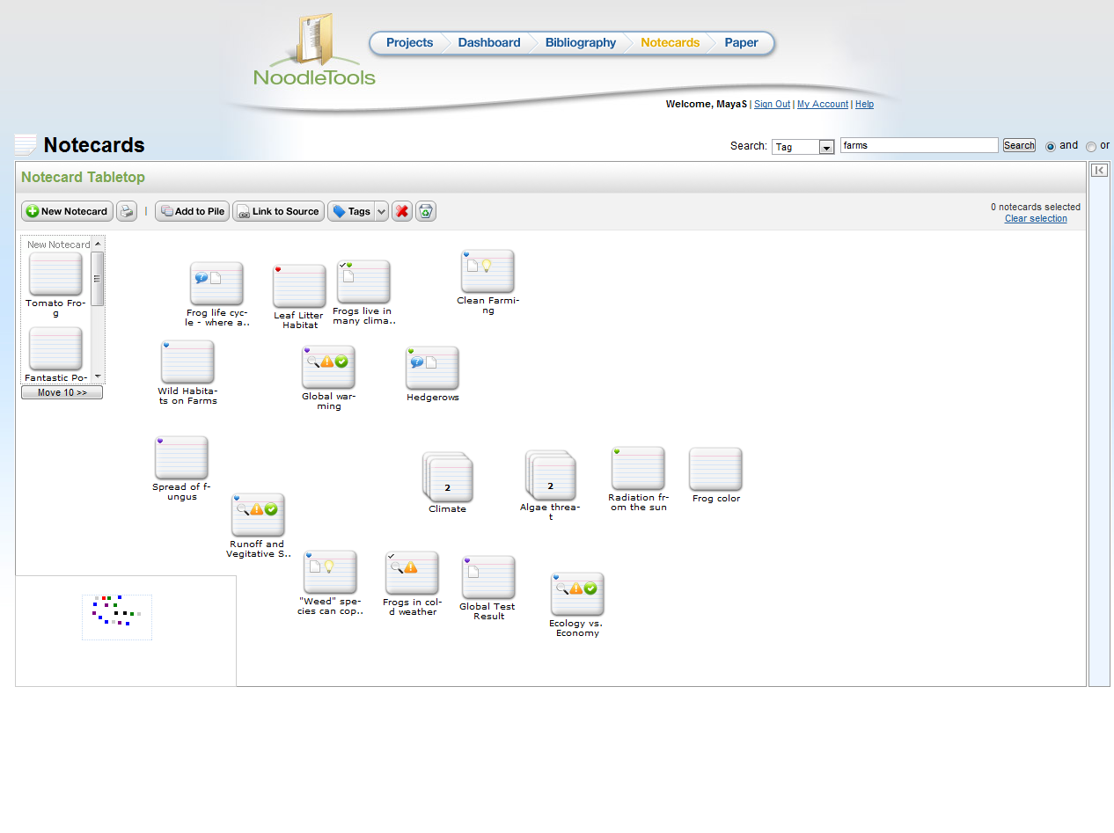
Your new notecards are waiting on the tabletop

Slide 29
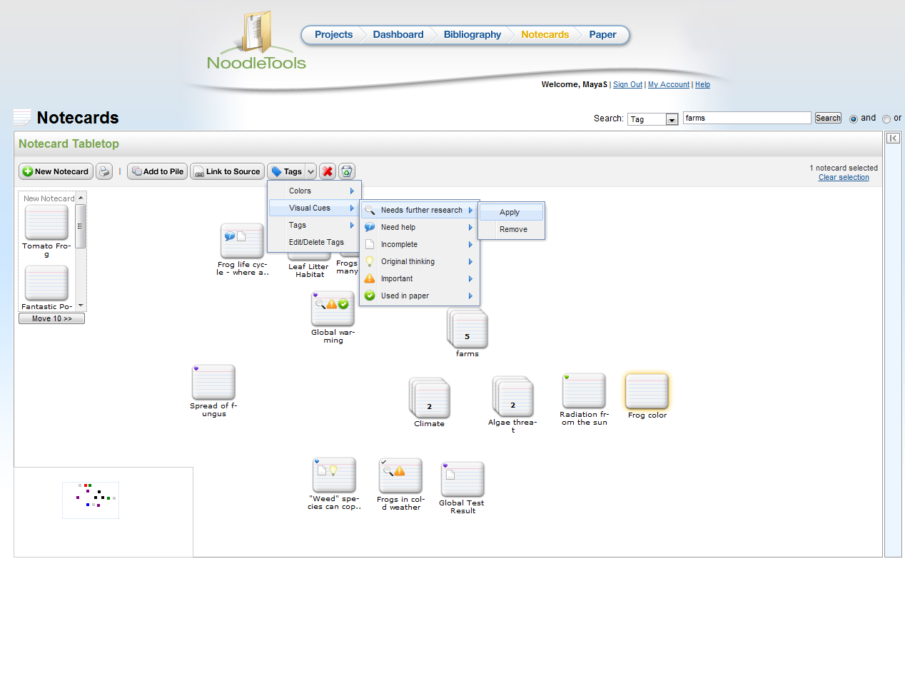
Add colors and cues to remind yourself what needs to be done and what’s important.

Slide 30
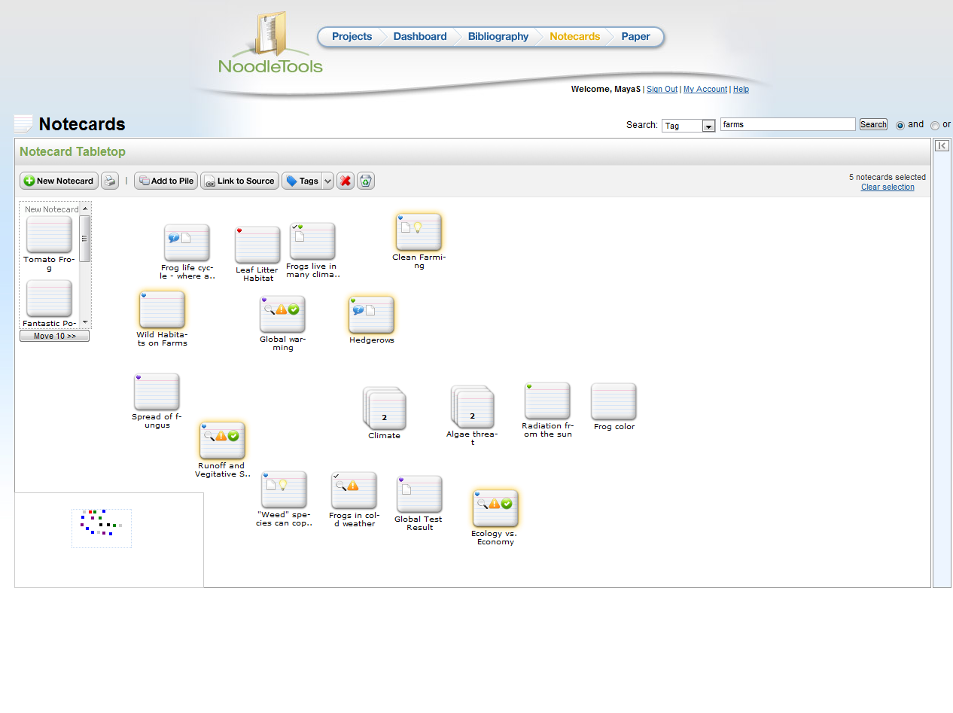
Search tags to highlight related ideas

Slide 31
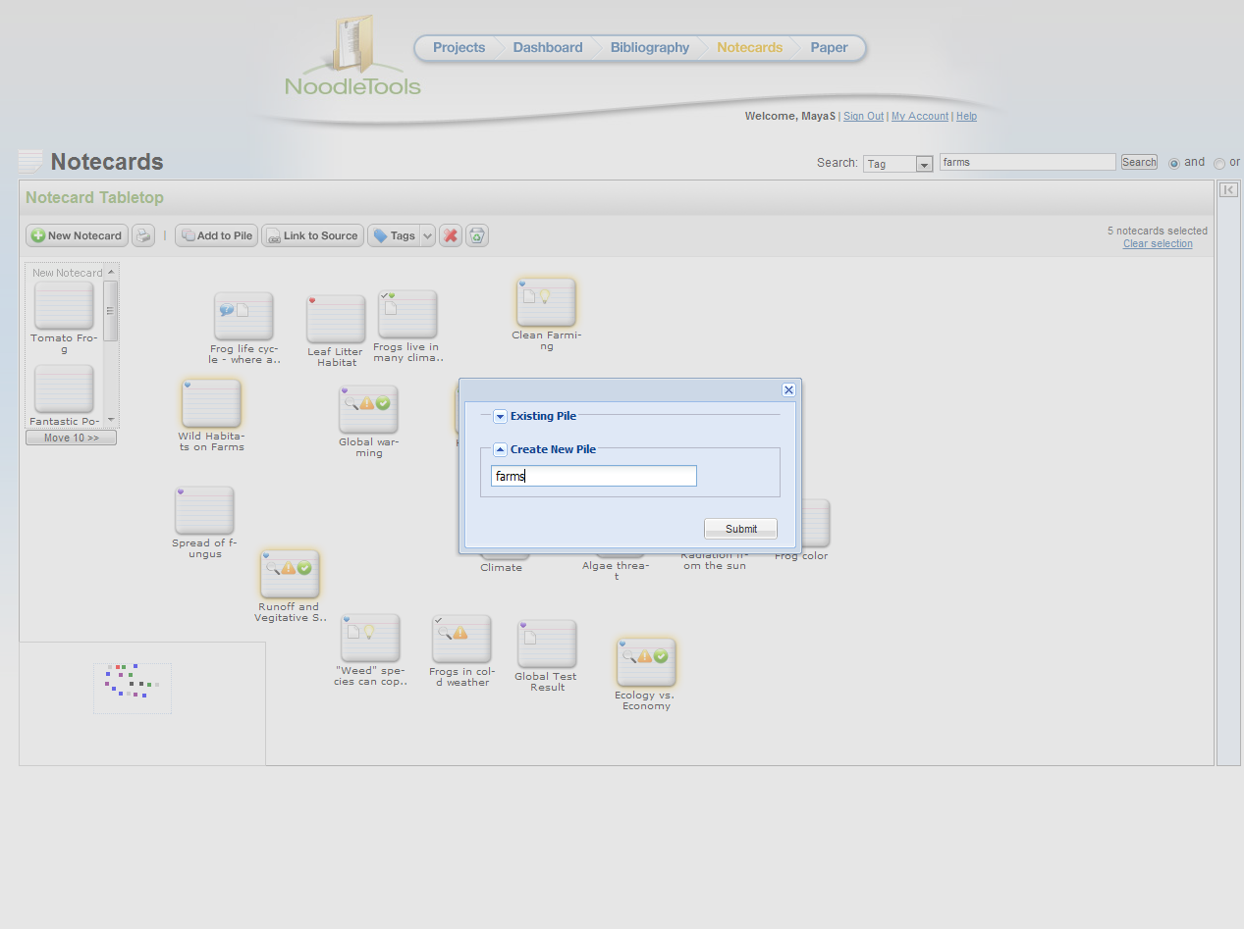
Create a new pile from your highlighted notecards

Slide 32
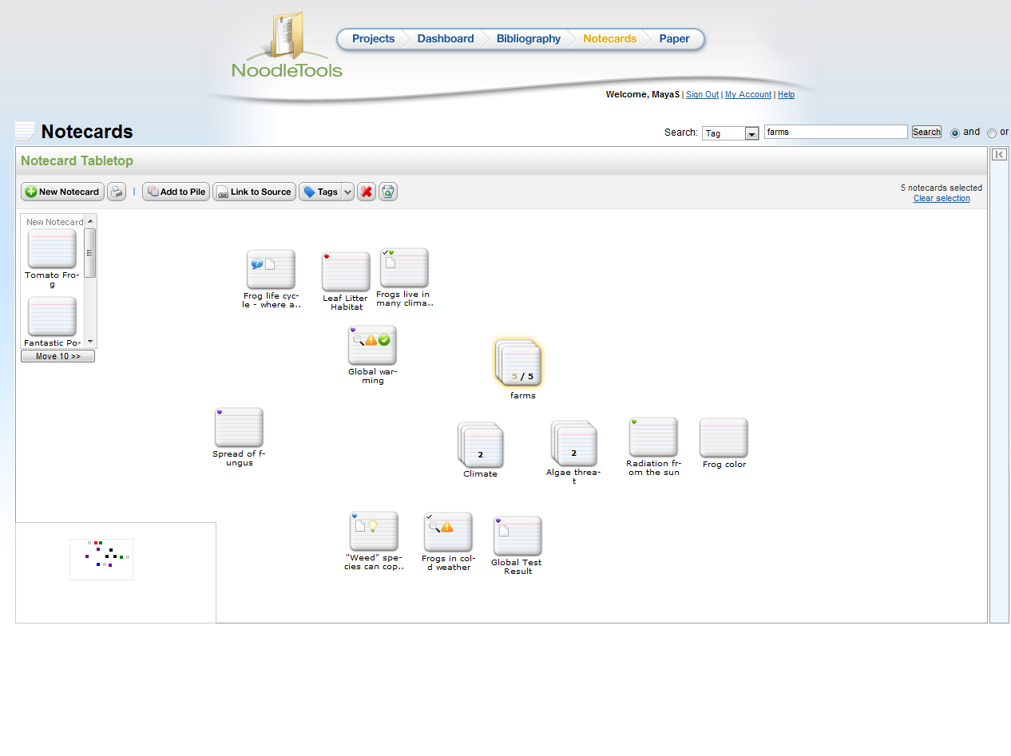
Piles are possible subtopics for an outline

Slide 33
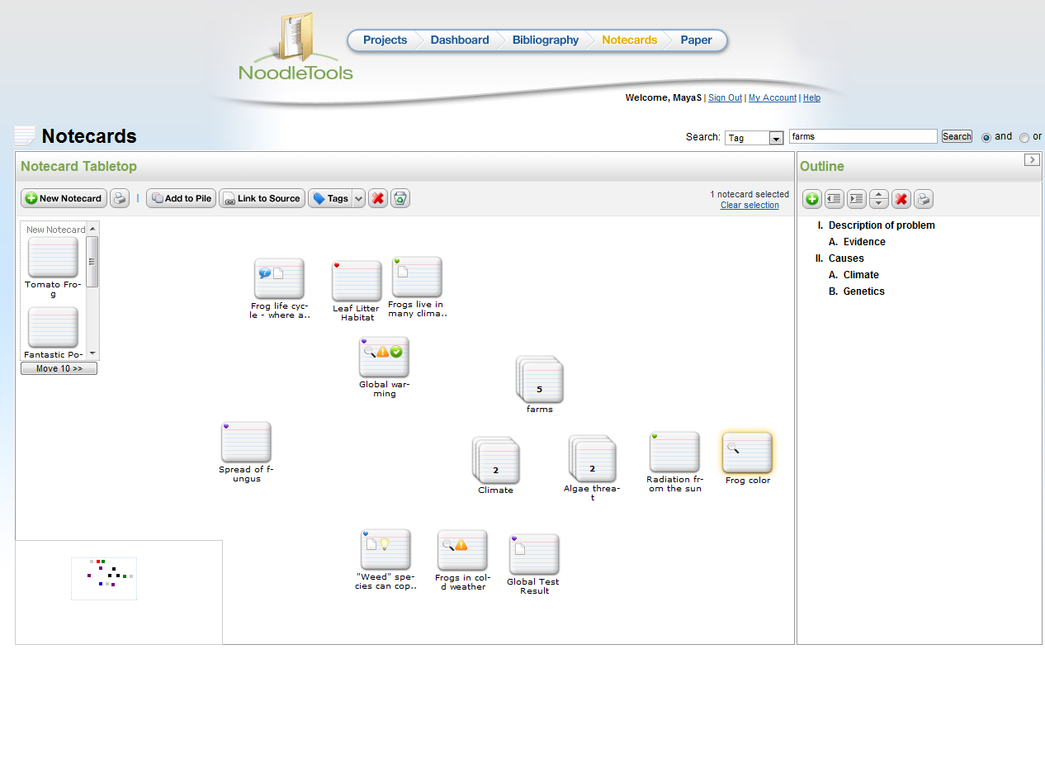
Build your outline
on-the-fly…
Notes:
http://www.noodletools.com/noodlebib/usersguide/index.html?n=NavigatingTheTabletop.html

Slide 34
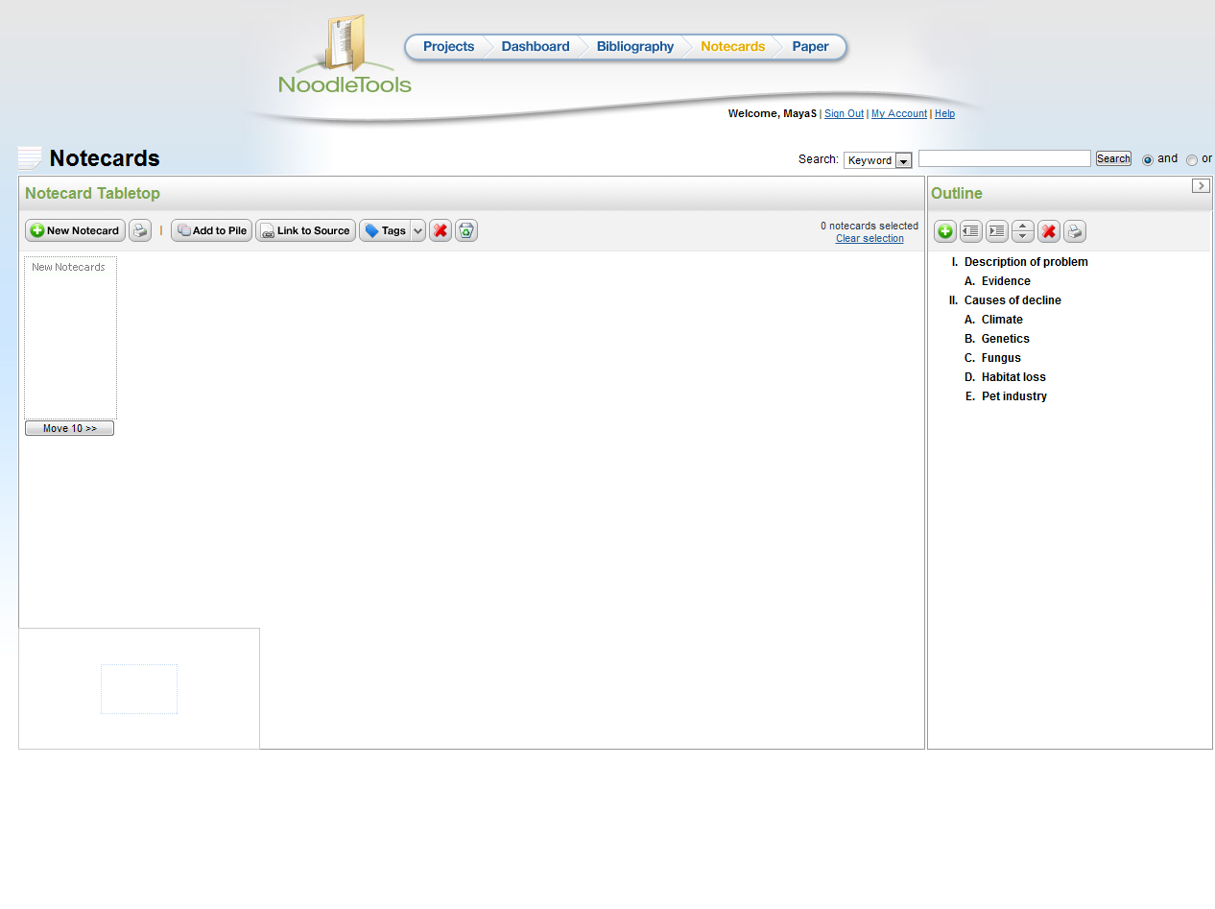
…or create it before you take notes.
Notes:
http://www.noodletools.com/noodlebib/usersguide/index.html?n=WhyUseAnOutline.html

Slide 35
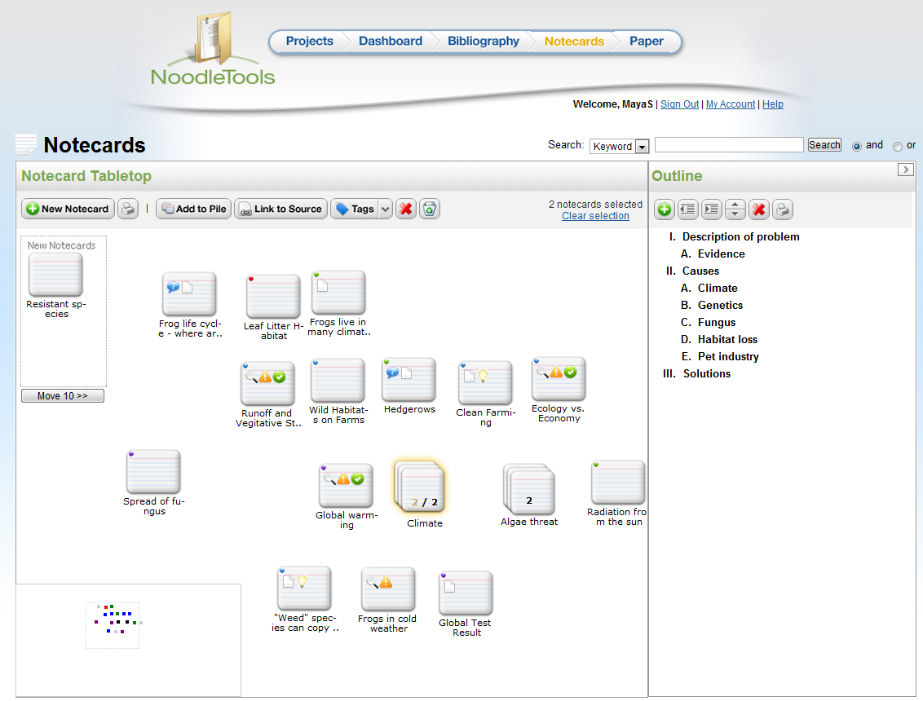
Drag notes and piles into your outline

Slide 36
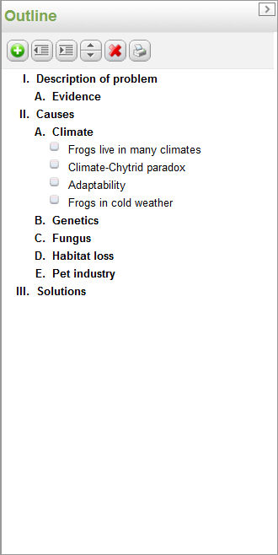
Watch your outline grow as you add notecards

Slide 37
Organize flexibly and playfully
What notes have similar titles or topics?
Pile them together
Add them to your outline
Experiment with the order, be curious!
What if I make new combinations of notes?
Search by one or more tags to find common ideas among notes
What other ways can I order my outline?
Do new grouping suggest new ways to analyze what I know? New ideas? New questions?

Slide 38
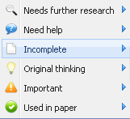
Review, reflect, reorder, revise
When you think you’re done, take another look!
Can I add more tags now that I know more?
Label details, themes, concepts
Other ways to order my ideas?
Reorder by searching on 2-3 tags at once
Any loose ends?
Are there types of sources I missed?
Use button to see the type and range of sources you used

Slide 39
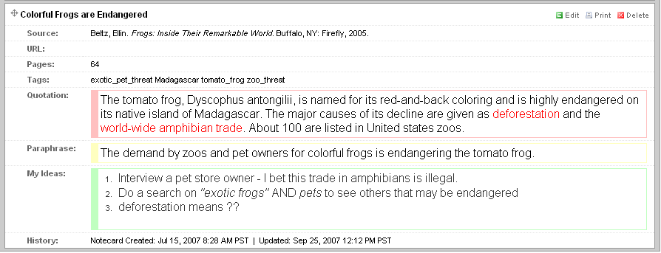
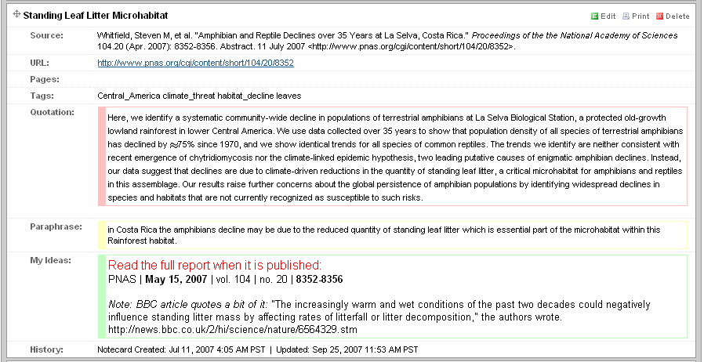
Don’t forget to follow your ideas!

Slide 40
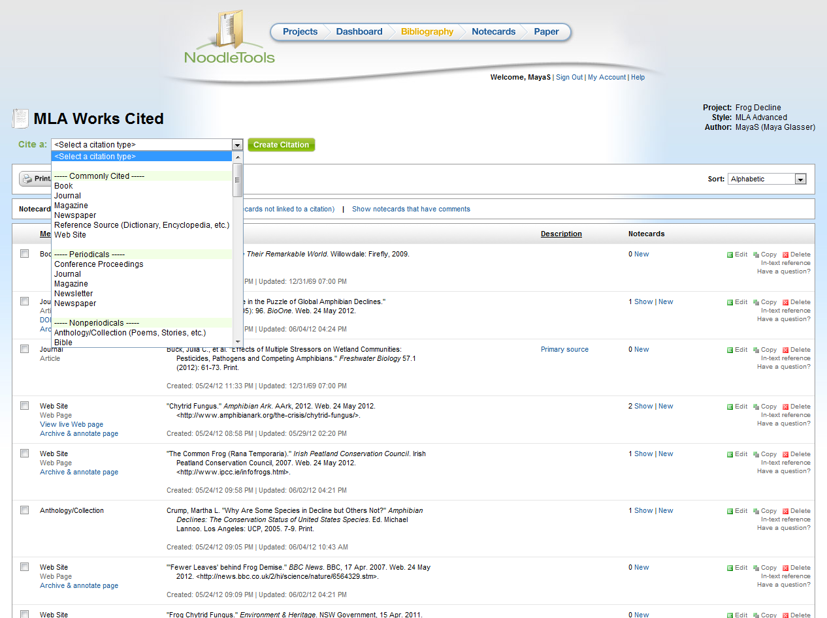
It’s easy to add more sources if you need to!

Slide 41
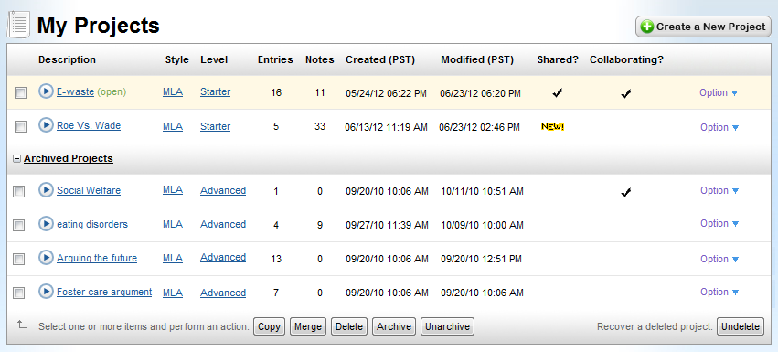
You can create a portfolio over time…
…and your work can never get lost!
Notes:
http://www.noodletools.com/noodlebib/usersguide/index.html?n=Overview2.html

Slide 42
Use your “noodle”!
Stay organized, feel successful
Access your work from home and school
Safeguard against accidental plagiarism
Spend your time thinking and creating (not on commas)
Get curious, feel creative…have fun!

Slide 43
“Noodle” time…start thinking!
Questions?
For more teaching ideas: support [at] noodletools [dot] com

